Slide 1

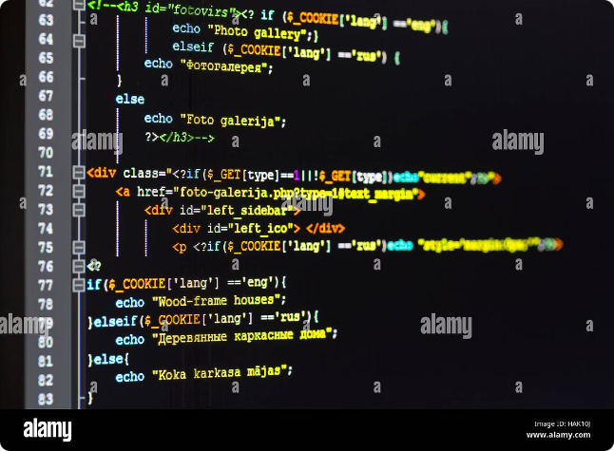

Understanding Compiler Design and Implementation
Compilers are essential software tools that translate human-readable code into machine-executable instructions. This presentation delves into the design and implementation of compilers, exploring the core concepts and stages involved in this intricate process.
by Hardik Bhammar

Slide 2


Introduction to Compilers
A compiler is a program that transforms source code written in a high-level programming language into low-level machine code that a computer can execute. This translation process is crucial for making software programs work on a variety of computer systems.
Key Components
Types of Compilers
A compiler typically consists of several components, such as a lexical analyzer, a parser, a semantic analyzer, and a code generator.
There are various types of compilers, including single-pass compilers, multi-pass compilers, and optimizing compilers, each with specific characteristics and advantages.
Compiler Design
Compiler design involves a systematic approach to creating efficient and robust compilers, considering factors such as language syntax, semantics, and target machine architecture.

Slide 3


Lexical Analysis
Lexical analysis, also known as scanning, is the initial phase of compilation. It involves reading the source code character by character and grouping them into meaningful units called tokens.
1
Tokenization
2
Symbol Table
Tokens represent the basic building blocks of a program, such as keywords, identifiers, constants, operators, and punctuation marks.
A symbol table is created to store information about the tokens, such as their type, value, and scope.
3
Error Handling
Lexical analysis also handles errors related to invalid characters, misspellings, and syntax inconsistencies.

Slide 4
Parsing
Parsing is the process of analyzing the token stream produced by the lexical analyzer to determine the grammatical structure of the program.
Syntax Trees
Parsing Techniques
Error Recovery
Parsing constructs a tree-like representation of the program, called a syntax tree, which captures the hierarchical relationships between the tokens.
Common parsing techniques include top-down parsing, bottom-up parsing, and recursive descent parsing, each with different strengths and weaknesses.
Parsers must handle syntax errors, such as missing tokens, incorrect operators, and unbalanced parentheses, by attempting to recover and continue parsing.

Slide 5


Abstract Syntax Trees
An abstract syntax tree (AST) is a simplified representation of the syntax tree that captures only the essential semantic information of the program.
1
Tree Structure
The AST uses nodes to represent program constructs such as expressions, statements, and declarations, with edges representing relationships between them.
2
Semantic Analysis
The AST provides a foundation for semantic analysis, which ensures that the program is logically and semantically correct.
3
Code Optimization
The AST is also used for code optimization, as it allows compilers to identify potential areas for improvement and transformation.

Slide 6





Semantic Analysis
Semantic analysis is the process of verifying that the program is semantically correct, ensuring that it adheres to the rules and constraints of the programming language.
Type Checking
Variable Declarations
Symbol Table
Type checking ensures that all operations are performed on compatible data types, preventing errors such as adding a string to an integer.
Semantic analysis verifies that all variables are declared before they are used and that their scope is properly defined.
The symbol table is used to store and retrieve information about variables, functions, and other program entities.

Slide 7

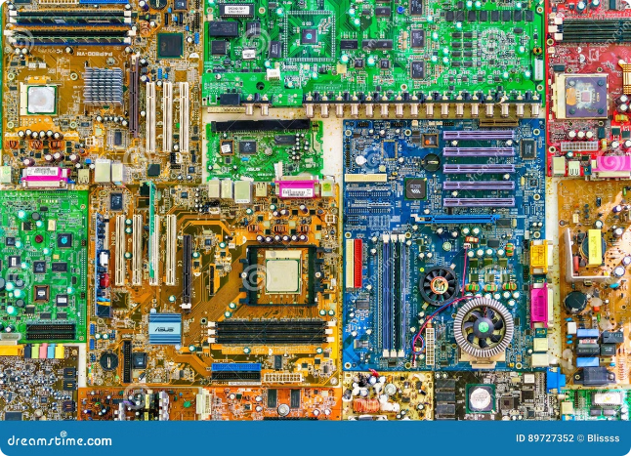
Intermediate Representation
An intermediate representation (IR) is a low-level representation of the program that is more abstract than machine code but easier to manipulate than the original source code.
Advantages
Code Optimization
Target Machine Independence
Disadvantages
Performance Overhead
Complexity of IR Generation

Slide 8


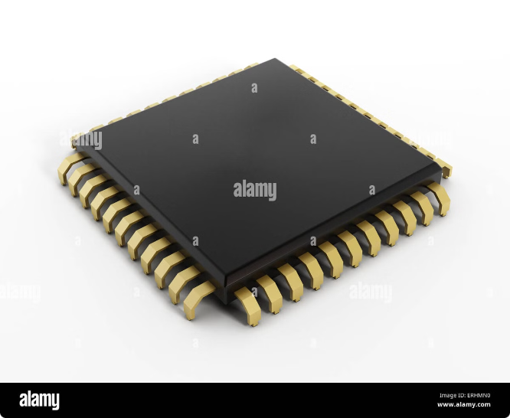


Code Generation
Code generation is the final stage of compilation, where the intermediate representation is translated into machine code that can be executed by the target machine.
Instruction Selection
The code generator selects appropriate machine instructions from the target machine's instruction set to implement the program's operations.
Register Allocation
Registers are limited resources within the CPU, and the code generator must efficiently allocate registers to store variables and intermediate values.
Memory Management
The code generator allocates memory for variables and data structures, ensuring proper memory addressing and access.

Slide 9

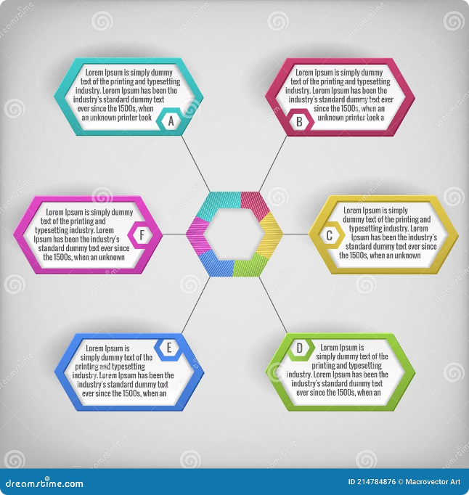
Optimization Techniques
Code optimization is a crucial step in compiler design, aimed at improving the efficiency and performance of the generated machine code.
1
Dead Code Elimination
2
Common Subexpression Elimination
Removes unused or unreachable code that has no impact on the program's output.
Identifies and eliminates redundant computations, reducing unnecessary calculations.
3
Instruction Scheduling
Rearranges instructions to maximize parallelism and minimize pipeline stalls, improving execution speed.

Slide 10


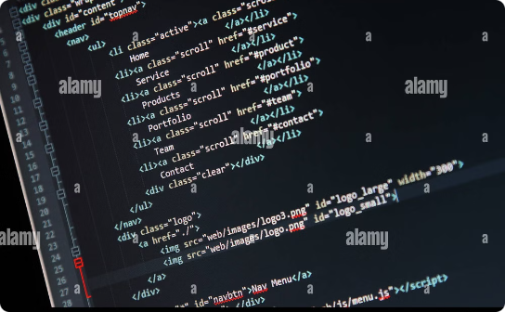
Challenges and Emerging Trends
Compiler design continues to evolve, facing new challenges and exploring emerging trends to address the complexities of modern programming languages and hardware architectures.
Parallel Programming
Language Evolution
Security Considerations
Optimizing compilers for parallel and distributed computing environments is essential for harnessing the power of multi-core processors and cloud computing.
Compilers must adapt to the constant evolution of programming languages, incorporating new features and addressing emerging paradigms.
Ensuring the security of compiled code is crucial to prevent vulnerabilities and malicious attacks, requiring advanced techniques for code analysis and hardening.

